Slide 1

Python programming Class 3
Abaddon Tsoi

Slide 2
條件語句(Conditional statements)
if
if … else
if … else … elif (* n)

Slide 3
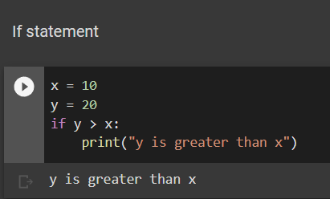
if

Slide 4
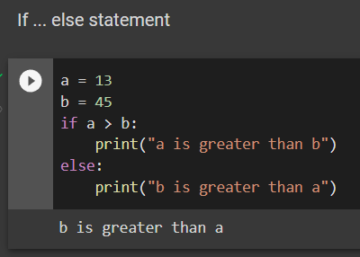
if … else

Slide 5
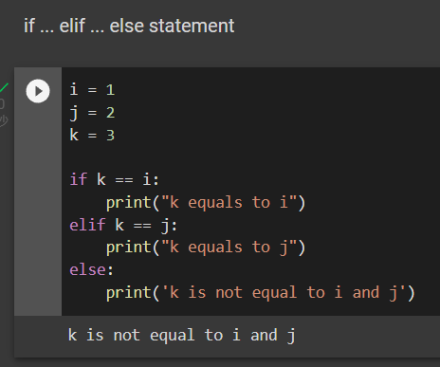
if … elif … else

Slide 6
迴圈(Loops)
While loop
For loop

Slide 7
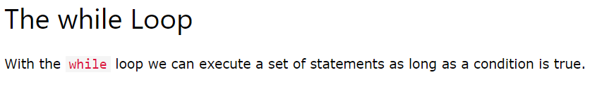
While loop

Slide 8
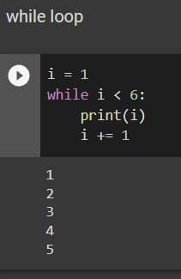
While loop

Slide 9
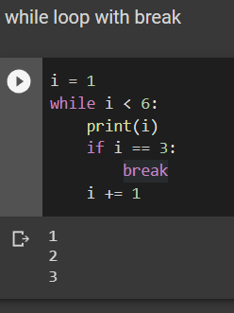
While loop with break

Slide 10
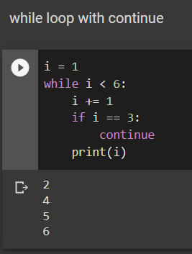
While loop with continue

Slide 11
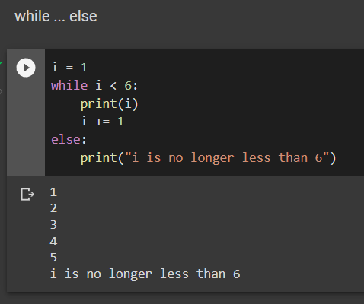
While … else

Slide 12
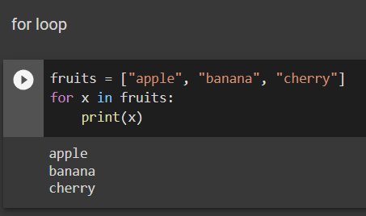
For loop

Slide 13
函數(Functions)
Create
Call

Slide 14
Creating function
Using “def” keyword
Define function name
Define parameter(s) -- optional
Define function content
Define function return value

Slide 15
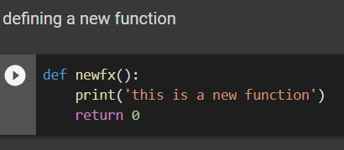
Example of creating new function

Slide 16
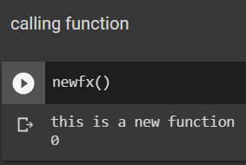
Call the function

Slide 17
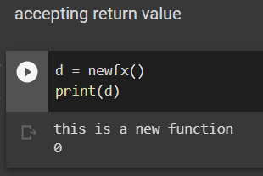
Accepting return value

Slide 18
Appendix
https://www.w3schools.com/python/

